Slide 1

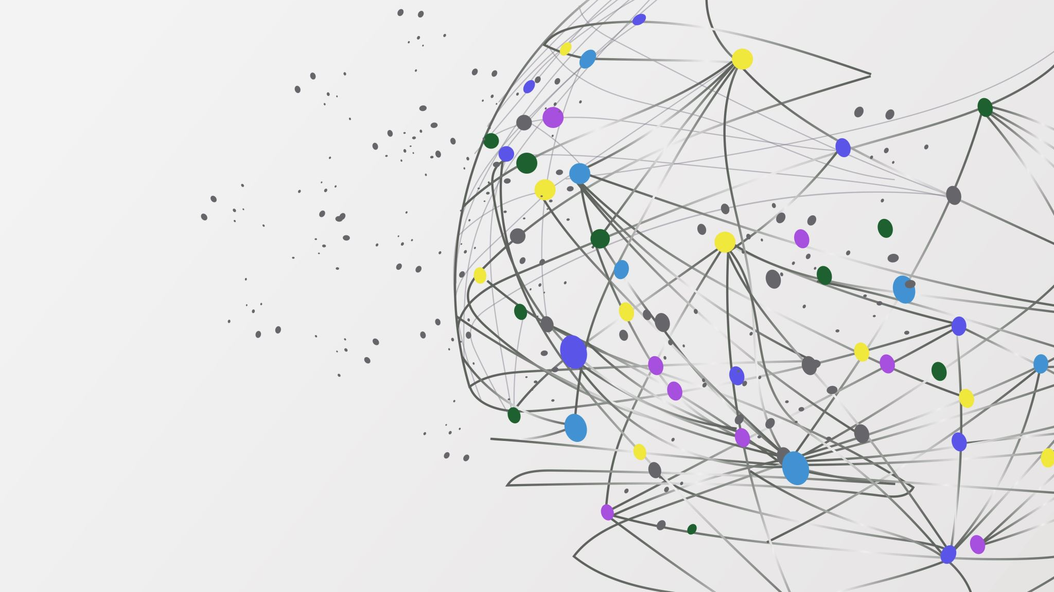
Realtime web applications
A google docs like project – by Michelle Weber Larsen & Kasper Bartholin Steenstrup Wogelius

Slide 2
Setup

Slide 3
NodeJS module

Slide 4
React

Slide 5
MongoDB

Slide 6
Strategy

Slide 7
Architecture

Slide 8
Test

